Slide 1
IOT Based Air Pollution Monitoring And Controlling System

Slide 2
ABSTRACT
The level of pollution is increasing rapidly due to factors like industries, urbanization, increasing in population, vehicle use which can affect human health.
IOT Based Air Pollution Monitoring System is used to monitor the Air Quality over a web server using Internet.
It will trigger an alarm when the air quality goes down beyond a certain level, means when there are sufficient amount of harmful gases present in the air like CO2, smoke, alcohol, benzene, NH3 and NOx.
It will show the air quality in PPM on the LCD and as well as on webpage so that air pollution can be monitored very easily.
The system uses MQ135 and MQ6 sensor for monitoring Air Quality as it detects most harmful gases and can measure their amount accurately.
And controlling the air pollution using air controlling system.

Slide 3
INTRODUCTION
Air pollution is the biggest problem of every nation, whether it is developed or developing.
Health problems have been growing at faster rate especially in urban areas of developing countries where industrialization and growing number of vehicles leads to release of lot of gaseous pollutants .
IOT Based Air Pollution Monitoring System monitors the Air quality over a web server using Internet and will trigger an alarm.
The system will show temperature and humidity. The system can be installed anywhere but mostly in industries and houses where gases are LPG gas is detected using MQ6 sensor and MQ135 sensor is used for monitoring Air Quality as it detects most harmful gases and can measure their amount accurately .
This system can be installed anywhere and can also trigger some device when pollution goes beyond some level, like we can send alert SMS to the user.

Slide 4
EXISTING SYSTEM
The conventional monitoring instruments are their large size, heavy weight and extraordinary expensiveness.
These lead to sparse deployment of the monitoring stations. In order to be effective, the locations of the monitoring stations need careful placement because the air pollution situation in urban areas is highly related to human activities (e.g. construction activities)
And location-dependent (e.g., the traffic choke-points have much worse air quality than average).

Slide 5
DISADVANTAGE
The drawbacks of the conventional monitoring instruments are their large size.
Heavy weight.
Extraordinary expensiveness.
Less efficency.

Slide 6
PROPOSED SYSTEM
Proposed Air Pollution Monitoring System is based on the block diagram as shown in Fig.1. The data of air is recognized by MQ135 gas sensor and MQ6 LPG gas sensor.
When the value will be less than 1000 PPM, then the LCD and webpage will display “Fresh Air”.
When the value will increase from 1000 PPM, then the buzzer will start beeping and the LCD and webpage will display “Poor Air, Open Windows”.
And when it will increase 2000, the buzzer will keep beeping and give an alert message on smartphone through GSM.
And the Controlling System turn on tocontrolthe air pollution.

Slide 7
ADVANTAGES
Easy to Install.
Updates On mobile phone directly.
Accurate Pollution monitoring.
Remote location monitoring.

Slide 8
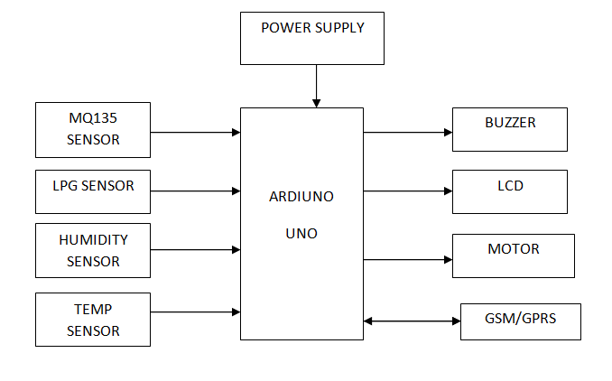
Block Diagram

Slide 9
HARDWARE REQUIREMENT
MQ135 Gas sensor
Arduino Uno
16x2 LCD
Buzzer
MQ 6 LPG gas sensor
Temperature sensor LM35
Humidity sensor SY-H522
GSM/GPRS
Motors

Slide 10
SOFTWARE REQUIREMENT
Arduino 1.6.13 Software
Embedded C Language

